Slide 1

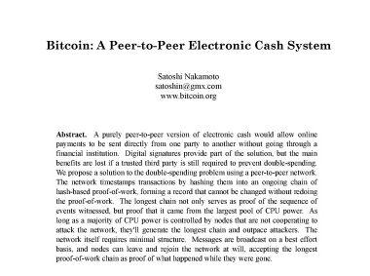
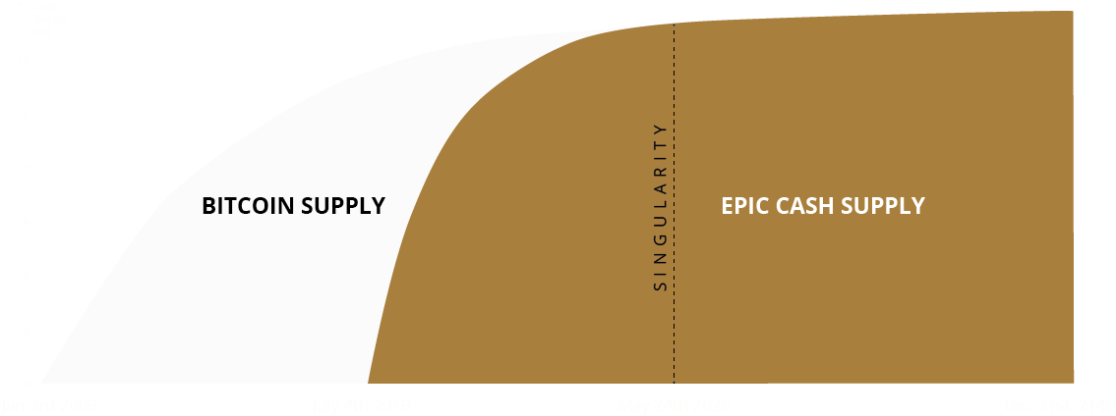




Bitcoin was originally envisioned as a medium of exchange but has evolved into digital gold, functioning almost solely as a store of value.
The potential still exists for a cryptographic store of value, integrated with a usable medium of exchange, but up until now that potential has not been fully realized.
EPIC is a novel software implementation of the original Bitcoin Standard, updated to the most recent technologies.
EPIC’s Rust-based Mimblewimble blockchain includes improvements in all of the attributes that will be necessary to foster mass adoption:
SCARCITY
A maximum supply of 21 PoW mined coins with an accelerated emissions schedule to match BTC’s supply by May 2028.
FUNGIBILITY
No tainted coins - featuring protocol-level, mandatory CoinJoin, resetting the ownership history each time coins are spent.
SCALABILITY
Light, fast, mobile-native protocol allows for a predominantly Layer 1 scaling model.
CENSORSHIP RESISTANCE
Transactions cannot be censored based on address or amount as no permanent addresses or externally observable data is stored in the chain.
CENTRALIZATION RESISTANCE
Mined on ordinary home computers, using CPUs from AMD and Intel, along with GPUs from AMD and Nvidia – leveling the playing field for small-scale miners.
REGULATORY COMPATIBILITY
Users interact directly with the blockchain - no custodial intermediary or third party trusted node required.
ACCESSIBILITY
Anyone can mine on an ordinary home computer, or even (soon) on a mobile device – enormous potential for unbanked users in developing economies.
Epic Cash is Howey compliant, designed to attain a score of "1” by the Crypto Rating Council.
Epic Cash is 100% proof-of-work mined, with no special nodes.
NO ICO
NO PREMINE
NO VC’s
NO COMPANY

Slide 2


EXTER’S PYRAMID
While EPIC functions as a cryptographic store of value, its paired stablecoin, EUSD, functions as a medium of exchange.
The ECR token provides governance for the Epicenter ecosystem and provides a backstop for the EUSD exchange rate.
1 EUSD = $1
worth of Epic Cash
EUSD is an ERC20 token, implemented through smart contracts on the Ethereum blockchain.
An EUSD holder is always guaranteed $1 worth of EPIC, regardless of the current print.
Epicenter consists of 3 composable components:
1. EPIC CASH PoW mimblewimble coin
2. ECR ERC20 token
3. EUSD ERC20 token
GROWTH: New dApp assets planned for release to drive DeFi utility and users
EPIC
ECR
EUSD
A store of value
Ecosystem utility governance
Algorithmically soft-pegged to the US dollar
Supported by Epicenter Equity Corp, a privately held, for-profit organization that facilitates EUSD/USD conversion through capital and liquidity provisioning in unison with partners.
With EPIC / ECR / EUSD as the core, DeFi applications are easily layered on top. Several are already under development, with multiple releases scheduled for the coming quarters.
Epic Epicenter info v1.4

